Slide 1







An Analysis:
IMPACT OF SELF-AWARENESS
ON AN INDIVIDUAL’S SUCCESS
Course: Probability and Statistics

Slide 2


Introduction
Self-awareness is the ability to recognize and understand one’s emotions, thoughts, and behaviors. It plays a vital role in personal growth, decision-making, and professional development.

Slide 3




Survey
Aim

Slide 4

This project aims to explore the role of self-
awareness in influencing individual success.
By examining how self-awareness impacts
goal-setting, emotional management, and
personal relationships, the study seeks to
understand its contribution to mental health
and overall achievement. The research will
highlight the importance of self-awareness
as a key factor in personal and professional growth..

Slide 5




Survey Demographics
Total Dataset:
209
18-25
26-35
36-45
46+
108 -> 86.1%
24-> 11.5%
4-> 1.9%
1 -> 0.5%
Age group 18-25 being the majority and other groups being minority.

Slide 6
Questionnaire
Total 16 Questions,
Categorized as

Slide 7
Self-Awareness as a Strength
Goal-Setting and Progress
Self-Awareness and Mental Health
Impact on Personal Relationships
Reactions to
Feedback and Criticism

Slide 8

Q#1
Q#4
What is your current life goal?
What is your response to an achievment?
Q#2
Q#5
How are you working towards achieving your goals?
How would you cope with a major setback or failure?
Q#3
Q#6
what is your progress towards your goal?
How do you react to feedback or criticism from others?

Slide 9
Q#7
Q#10
What steps do you take to stay self-aware?
How do self-aware individuals typically carry themselves in public?
Q#8
Q#11
How does self-awareness impact your mental health?
How do you manage emotions in stressful situations?
Q#9
Q#12
How has self-awareness changed your personal relationships?
Do you believe self-awareness is a strength or a weakness?

Slide 10
Q#13
Q#14
Do you believe self-awareness leads to better decision-making?
How do you handle conflicting values with societal norms?
Q#15
How important is self-awareness in achieving personal happiness?

Slide 11
Goal-Setting and Progress

Slide 12

Goal-Setting and Progress
1. What is your current life goal
H₀: Life goal status and progress towards goal are independent.
H₁: Life goal status and progress towards goal are related.
We will reject the H₀ of independence. Hence, life goal clarity does indeed influence progress.
Chi-square: 57.99
P-value: 0.0000

Slide 13
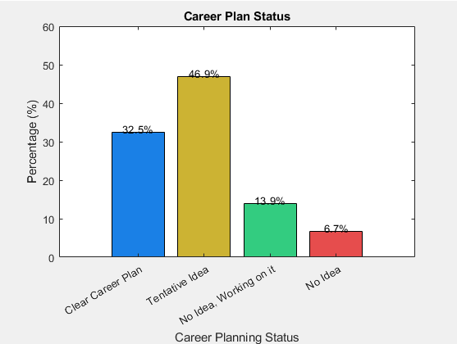

Slide 14
Goal-Setting and Progress
2. How are you working towards achieving your goals.
H₀: How you are working towards your goals and belief in self-awareness are independent.
H₁: How you are working towards your goals and belief in self-awareness are dependent.
We will reject the H₀, showing that how people work towards their goals is linked to their belief in self-awareness improving decision-making.
Chi-square: 33.79
P-value: 0.0000

Slide 15
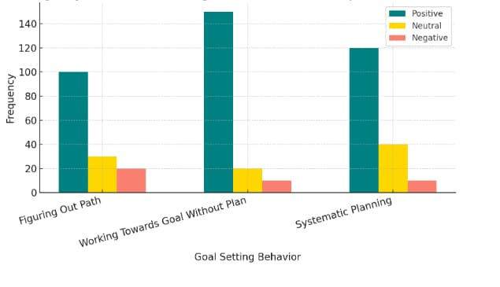

Slide 16
Self-Awareness and Strength
3. what is your progress towards your goal.
H₀: The mean of goal progress ≠ 5.
H₁: The mean of goal progress = 5.
We reject the H₀ of equal means and accept H₁.
Mean value: 5.23

Slide 17
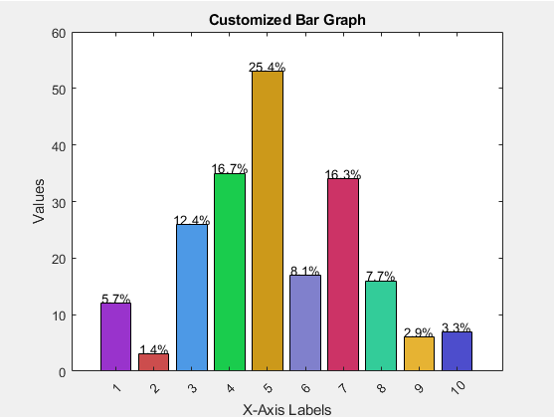

Slide 18
Goal-Setting and Progress
4. What is your response to an achievement.
H₀: How people respond to achievements has no effect on how they cope with setbacks
H₁: The way people respond to achievements shapes how they cope with setbacks
We will reject the H₀ of independence. Hence, proving that response to success shapes approach to failure, highlighting a clear connection between achievement reactions and setback coping strategies.
Chi-square: 15.01
P-value: 0.0202

Slide 19
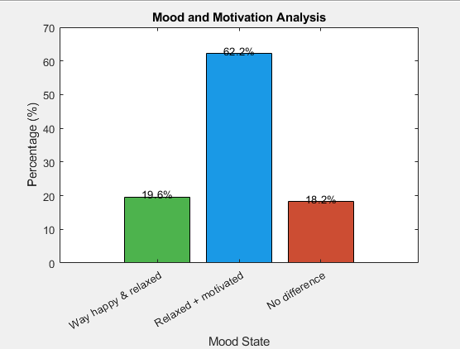

Slide 20
Self-Awareness
and Mental
Health

Slide 21
Self-Awareness and Mental Health
5. How does self-awareness impact your mental health.
H₀: P Improved​ = P Not Improved
H₁: P Improved​ ≠ P Not Improved
(α=0.05, two-tailed test)
At a 95% confidence level, we reject the H₀ and hence,
There is a significant difference between the proportions.
Z-calculated = 2.511
Z-tab = ±1.96

Slide 22
Self-Awareness and Mental Health
5. How does self-awareness impact your mental health.
Lower Upper
1. Improved 0.411 0.345 0.478
2. Still Analyzing 0.502 0.435 0.570
3. Not Improved 0.086 0.048 0.124
Proportion
Confidence Interval (95%)

Slide 23
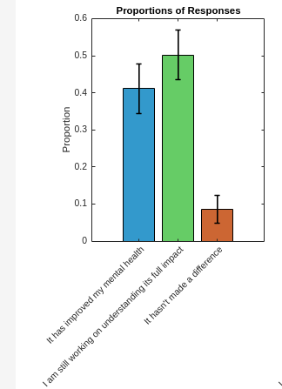

Slide 24
Self-Awareness and Mental Health
6. How do you manage emotions in stressful situations
H₀: How people handle stress doesn't affect how they behave in public.
H₁: How people handle stress influences how they behave in public.
We reject the H₀, indicating that stress management
affects how individuals behave in public.
Chi-square: 21.40
Critical Value: 5.99

Slide 25
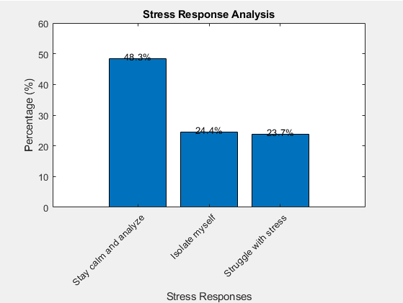

Slide 26
Self-Awareness
and Strength

Slide 27
Self-Awareness and Strength
7. How would you cope with a major setback or failure
H₀: Coping with setbacks is unrelated to achievement response.
H₁: How individuals cope with setbacks is related to their response to
achievement.
We fail to reject the H₀, indicating that how individuals cope with
setbacks is unrelated to their response to achievement.
Chi-square: 1.78
P-value: 0.9387

Slide 28
Self-Awareness and Strength
8. Do you believe self-awareness is a strength or a weakness.
H₀: The belief about self-awareness is equally distributed across all categories.
H₁: The belief about self-awareness is not equally distributed across the categories.
We will reject the H₀ and hence, the perception of
self-awareness is not equally distributed across all categories.
Chi-square: 49.00
Critical-value: 7.81

Slide 29
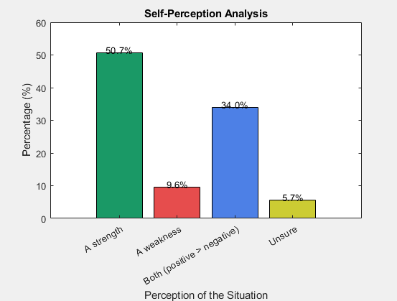

Slide 30
Self-Awareness
and Personal
Relations

Slide 31
Self-Awareness and Personal Relations
9. How has self-awareness changed your personal relationships
H₀: P:Improved​ = 0.5
H₁: P:Improved​ > 0.5
(α=0.05, one-tailed test)
We reject H₀ and hence, people with self-awareness perceive a
greater positive impact on their relationships compared to others.
Z-calculated: 5.66
Z-tab: 1.645

Slide 32
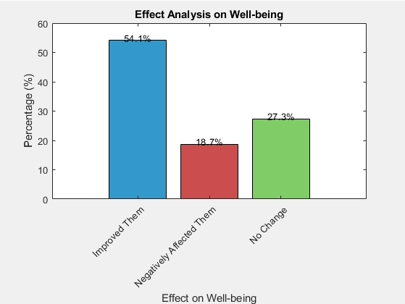

Slide 33
Self-Awareness and Personal Relations
10. How do self-aware individuals typically carry themselves in public.
H₀: Self-aware individuals are equally distributed across the behavior categories.
H₁: Self-aware individuals are not equally distributed across behavior categories..
We reject the H₀, and accept H₁ .
Chi-square: 14.71
Critical Value: 12.59

Slide 34
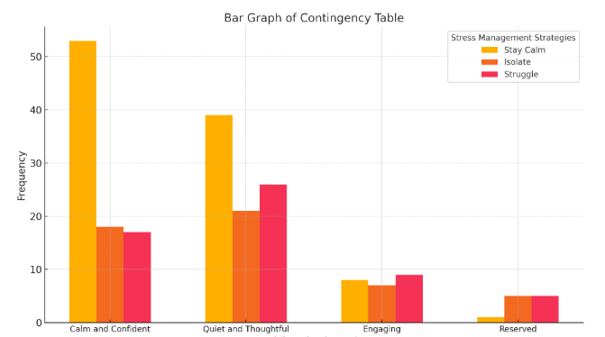

Slide 35
Reaction to
Criticism and
Feedback

Slide 36
Feedback And Criticism
11. How do you react to feedback or criticism from others.
H₀: Proportions for all categories are equal (p1​=p2​=p3​=1​/3)
H₁: At least one of the proportion isn’t equal
At a 95% confidence level, we reject the H₀ and hence,
accept H₁.
Chi-square: 90.0383
P-value: 0.0000

Slide 37
Feedback And Criticism
11. How do you react to feedback or criticism from others.
Proportion
Confidence Interval (95%)
Lower Upper
1. 0.6029 0.5365 0.6692
2. 0.3301 0.2664 0.3939
3. 0.0670 0.0331 0.1009

Slide 38
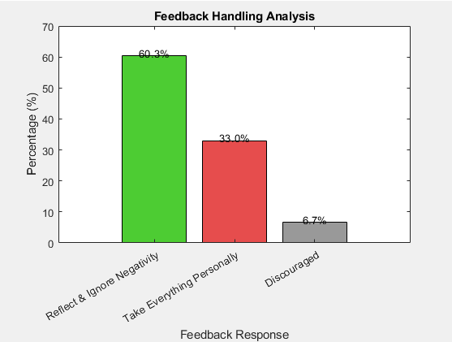

Slide 39
Feedback And Criticism
12. Do you believe self-awareness leads to better decision-making
H₀: P: Yes​ = 1/3, P: No​ = 1/3, P: I don’t know ​= 1/3
H₁: At least one of the proportion isn’t equal
We will reject the H₀ and hence, people with
self-awareness believe it improves decision-making more than others.
Chi-square: 245.56
Critical-value: 5.99

Slide 40
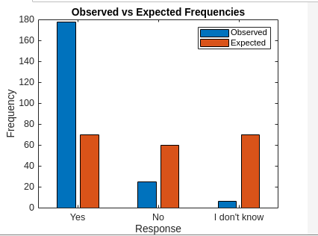

Slide 41
Feedback And Criticism
13. What steps do you take to stay self-aware
H₀: How individuals stay self-aware is unrelated to how they cope with setbacks.
H₁: How individuals stay self-aware is related to how they cope with setbacks
We will reject the H₀, suggesting that how individuals stay
self-aware is related to how they cope with setbacks.
Chi-square: 35.38
Critical-value: 5.99

Slide 42
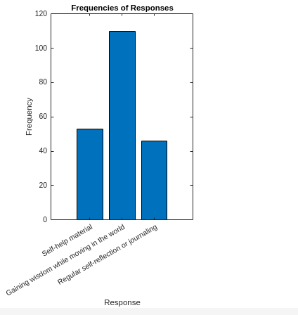

Slide 43
Limitations And Future Work
This study is limited by a small dataset and centralized data, which may restrict the generalizability of the findings. Future research could expand the sample size, incorporate more diverse participants, and use longitudinal methods to track changes over time. Additionally, redesigning the survey and exploring alternative data collection methods, such as interviews, could offer deeper insights into the role of self-awareness in success

Slide 44
Thank
You!

